Slide 1

SECTION 1 –
What is programming ?
PYTHON BASICS – LEARN PYTHON PROGRAMMING
FOR BEGINNERS

Slide 2
Section 1 – What is Programming?
1.1 Meaning of programming
The word programming comes from “program,”
which originally meant a plan, schedule, or list of steps.
A program is a sequence of instructions with a goal.
PYTHON BASICS – LEARN PYTHON PROGRAMMING
FOR BEGINNERS

Slide 3
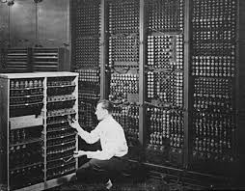
Section 1 – What is Programming?
    1.2 Why Programming Was Created?
First computers were massive
People had manually rewire them to change task
Programming turned computers from “calculators” into “creators.”
PYTHON BASICS – LEARN PYTHON PROGRAMMING
FOR BEGINNERS

Slide 4
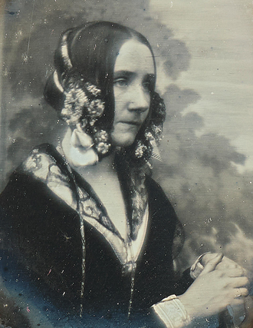
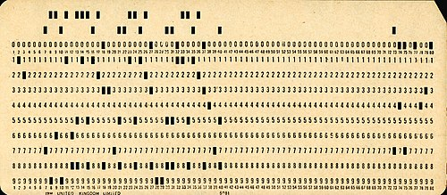
Section 1 – What is Programming?
1.3 A Quick Time Travel Through Programming History
In the 1800s Ada Lovelace wrote instructions
for Charles Babbage’s “Analytical Engine.”
In the 1940s writing code meant
punching wholes in paper cards
Today the term programming describes the process of planing
and writing instructions that computer can follow
PYTHON BASICS – LEARN PYTHON PROGRAMMING
FOR BEGINNERS

Slide 5
Section 1 – What is Programming?
1.4 What is Exactly Programming Today?
Programming is teaching a computer how to solve problems.
Computers follow every detail perfectly — but only if you tell
them exactly what to do.
Programming = problem solving + logic + creativity.
PYTHON BASICS – LEARN PYTHON PROGRAMMING
FOR BEGINNERS

Slide 6
Section 1 – What is Programming?
1.5 Why Programming Matters?
Programming is everywhere
Mastering programming with help you:
1. Think logically
2. Solve problems
3. Create solutions from zero
PYTHON BASICS – LEARN PYTHON PROGRAMMING
FOR BEGINNERS

Slide 7
Section 1 – What is Programming?
1.6 SECTION SUMMARY
Programming is:
-communication
-creativity
-power
PYTHON BASICS – LEARN PYTHON PROGRAMMING
FOR BEGINNERS

